Slide 1

HOW TO BUILD A PROFITABLE, AUTOMATED, SUSTAINABLE, RECESSION-PROOF
CREDIT REPAIR BUSINESS
(Even if you have no clue where to start!)
Notes:
Welcome, Welcome, Welcome!
Welcome to the class.
My name is Dominique Brown and I will be your host.
The name of this class is How To Drastically Improve Your Credit Score without Wasting Money on Expensive Credit Repair Services.. Even if you have no clue where to start!
Let’s do a quick sound and sight test.
If you can hear me and see the screen press #3
Once again…
If you can hear me and see the screen press #3
Oh… If you’re having issues with the connection. Press the “reconnect” button now.
Make sure that if you’re on a laptop or mobile device that you shut down other applications and give this class your undivided attention and internet bandwidth!
Just a heads up my assistant will be helping out with the chat and I will be 100% focused on the presentation if you have a question post it in the chat box and my assistant will assist you or just hold your question until we do our Q&A session at the end.

Slide 2
Most credit repair business owners fail in the business because of lack of structure in their business. this is a very common mistake that a lot of business owners make when it comes to getting into business. In this webinar go over the foundational structure that you will need to start your credit repair business the right way and set it up for it to scale to the moon,​​​​​​​once the foundation is set!
Notes:
Specifically, I’m going to show you what I did to improve my credit score from 504 to 800+ actually I have two perfect credit scores now and how I have helped thousands of others improve their credit scores as well!
This has allowed people just like you to go on to buy cars, homes, start businesses and take back control of their financial situation.

Slide 3
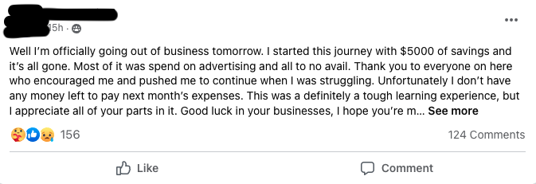
THIS IS WHAT HAPPENS
Notes:
As a matter of fact, here are a few images of results from my students. These are people who invested in their financial future and have enrolled in my do it yourself financial academy called the YFS Academy. On the left we have April a single mom of 3 who was able to buy a home for her kids and get away from their nasty landlord. on the right we have Tashina who was able to get her student loans deleted. A lot of people do not know that you can actually have student loans removed from your credit reports.

Slide 4
My Goal...
I’m going to teach you the PROPER way to build a Credit Repair Business in 2022
Notes:
My goal for this webinar is to teach you the FASTEST way to improve your credit without paying for expensive credit repair services and to empower you to take action on improving your financial situation. I’m excited because I taught this class a lot and each time it’s just amazing to see people get that “Ah-Ha” moment and taking steps to change their life for the better.

Slide 5
My Goal...
I’m going to teach you my Guaranteed methods to Be always be Profitable.
I’m going to teach you how to make a sustainable credit repair business.
I’m going to also each you how to automate the whole process.
I going to teach you my 5 pillars of credit repair blueprint framework.
Even If you don’t know where to start...
Notes:
Now to really break this down a little bit more. I will show you how to build your credit score quickly and permanently even if you have bad, low or no credit.
I will show you my 7 step process for removing negative items from your credit. I’m talking late payments, collections chargeoffs, public records. The nasty stuff from your past that’s holding you back. So you can leverage your improved mindset, financial knowledge and credit to obtain homes, cars and rental properties... without Getting denied!
I’m going to show you how to do this even if you don’t know where to start! You do not need to be a financial expert for this to work.

Slide 6
What You Will Learn...
Secret #1: How To Build a Credit Business from scratch with the right foundation.
Secret #2: Why credit repair is a very lucrative recession proof business
Secret #3: How To Maximize your profits for your business
Secret #4: WHAT are The 5 pillars of Credit Repair (my own secret framework)
Secret #5: HOW TO AUTOMATE IT ALL!!!!!
Notes:
You’re going to learn 3 secrets to reaching your credit goals today. Secret #1 How To Remove Negative Items From Your Credit Report. Secret #2 is How To Improve Your Credit Without Being A Credit Expert and Secret #3 How To Improve Your Credit When You Are Short On Time!

Slide 7
Who This Is For..
The person who want to Build a profitable, sustainable, automated, recession proof credit repair business
Realtors, loan officers, Dealership salesperson, tax professionals
Looking to get into the finance industry with capitalize in a very lucrative market
A individual who’s looking to build wealth & become more financially free
Notes:
Ok, so we know what this class is about, but who is this for? If you are a do it yourself type person and you want to understand how credit works, so you can drastically improve your credit score on your own. This class is for you.
This class is for you if you want to stop renting and own a home or rental property
This class is for you if you want to obtain assets instead of liabilities
This class is for you if you want to build wealth, save more and become financially free
If you’re a person who wants more than what they are getting now and you’re tired of not getting the what you deserve.
If that sounds like you… you’re in the right place!!

Slide 8

IF YOU STAY UNTIL THE END…...
Notes:
Now, if you stay until the end of this class. I will sweeten the pot and provide you a gift! I want to help you on your credit journey I’ll send this to you if you make it to the end of the class and participate in the Q&A session.

Slide 9
SPEACIAL OFFER IN PLACE FOR YOU
Notes:
Now, if you stay until the end of this class. I will sweeten the pot and provide you a gift! I want to help you on your credit journey I’ll send this to you if you make it to the end of the class and participate in the Q&A session.

Slide 10
I WANT YOU TO KNOW THIS...
Notes:
YOU CAN DO THIS! THIS IS VERY POSSIBLE FOR YOU. I BELIEVE MOST PPL DON’T EVEN GET STARTED BECAUSE THEY GET INTIMATED BY ALL THE WORK A BUSINESS HAS AND IT COMES WITH BUT WE CAN MAKE IT EASIER TO MANAGE WHEN YOU BREAK IT ALL DOWN.

Slide 11
Ok… But Who Are You? Why Should I listen?
Notes:
So you might be wondering but who is Dominique Brown and why should I listen to you out of all the “credit guru’s” and “experts” What makes you so special and that’s a really great question!

Slide 12
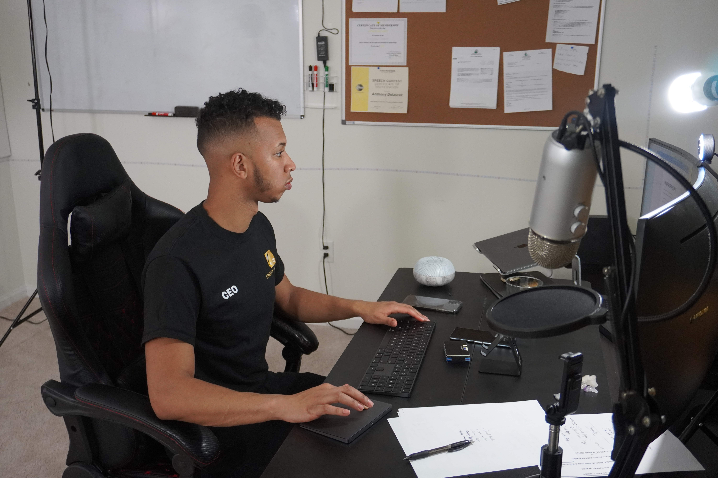
I’m the founder and CEO of Crbaprogram.com, helping credit repair business owners succeed in their businesses
I built a 7 figure credit repair company for the last 3 years
Taught thousands of people to Understand, Repair, improve their credit and start businesses.
Notes:
A lot of you know me, but a lot of you don’t know me.
So I need to give you a little bit of my background so you know who you’re dealing with and why I’m so confident in what I will be teaching you today..
My name is Dominique Brown aka Mr. Perfect Credit Score.
I have one of the best credit scores in the country. I’m actually in the top 1%.
I’m the owner of the brand YourFinancesSimplified.com and YFSAcademy.com. I run a 7 figure credit repair company and I’ve mentored a lot of the people you know and love in the credit repair industry.

Slide 13
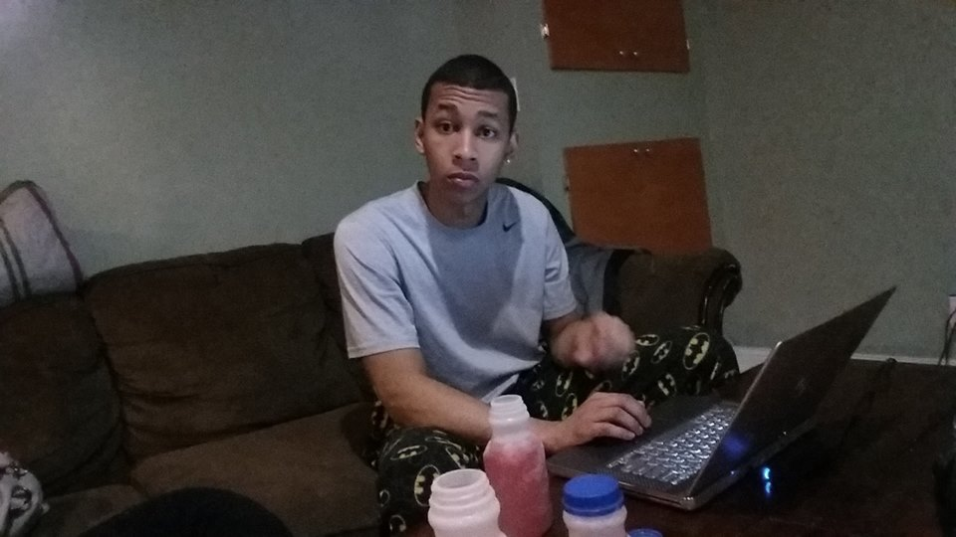

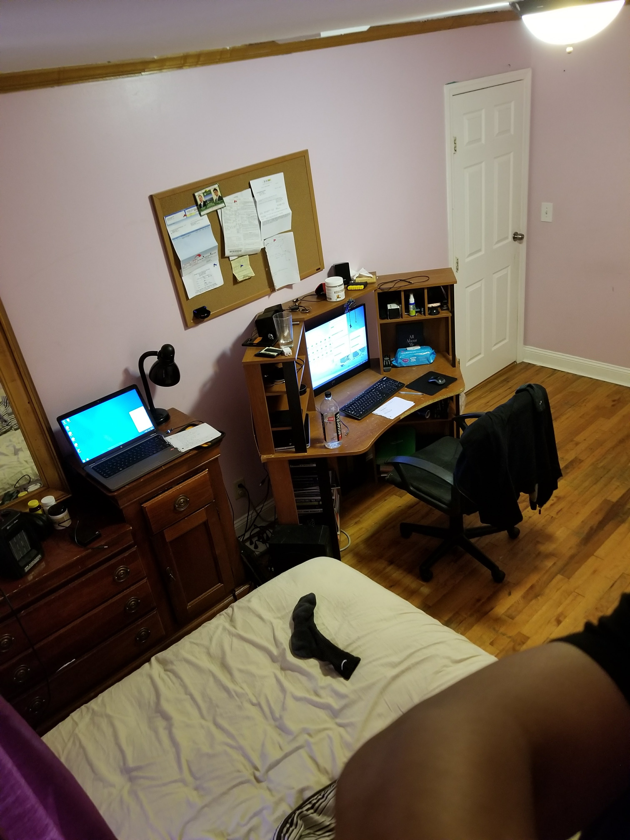
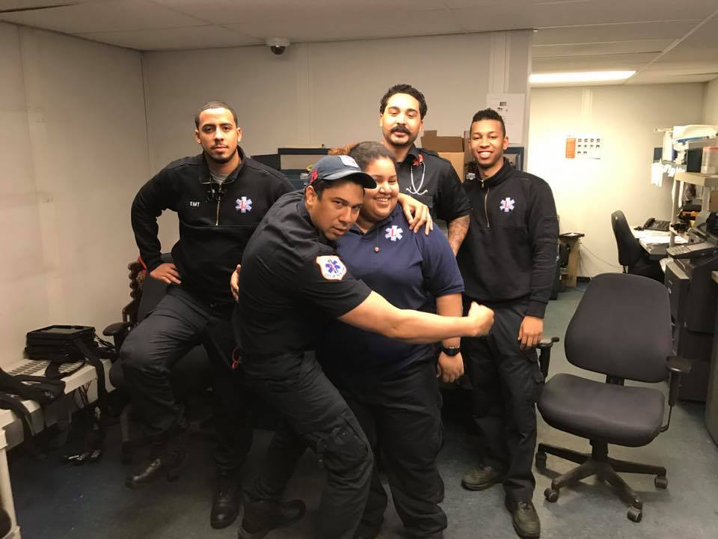

Notes:
I also have a lovely, caring and super dope wife who goes by the name of Coach Sheena and she blessed me with my baby girl Olivia.
We travel every 2-3 months, invest 50% of our income into real estate, the stock market, our businesses and met some pretty amazing people and it’s all because we took control of our finances, improved our credit and moved systematically towards our goal with a proven systems!

Slide 14
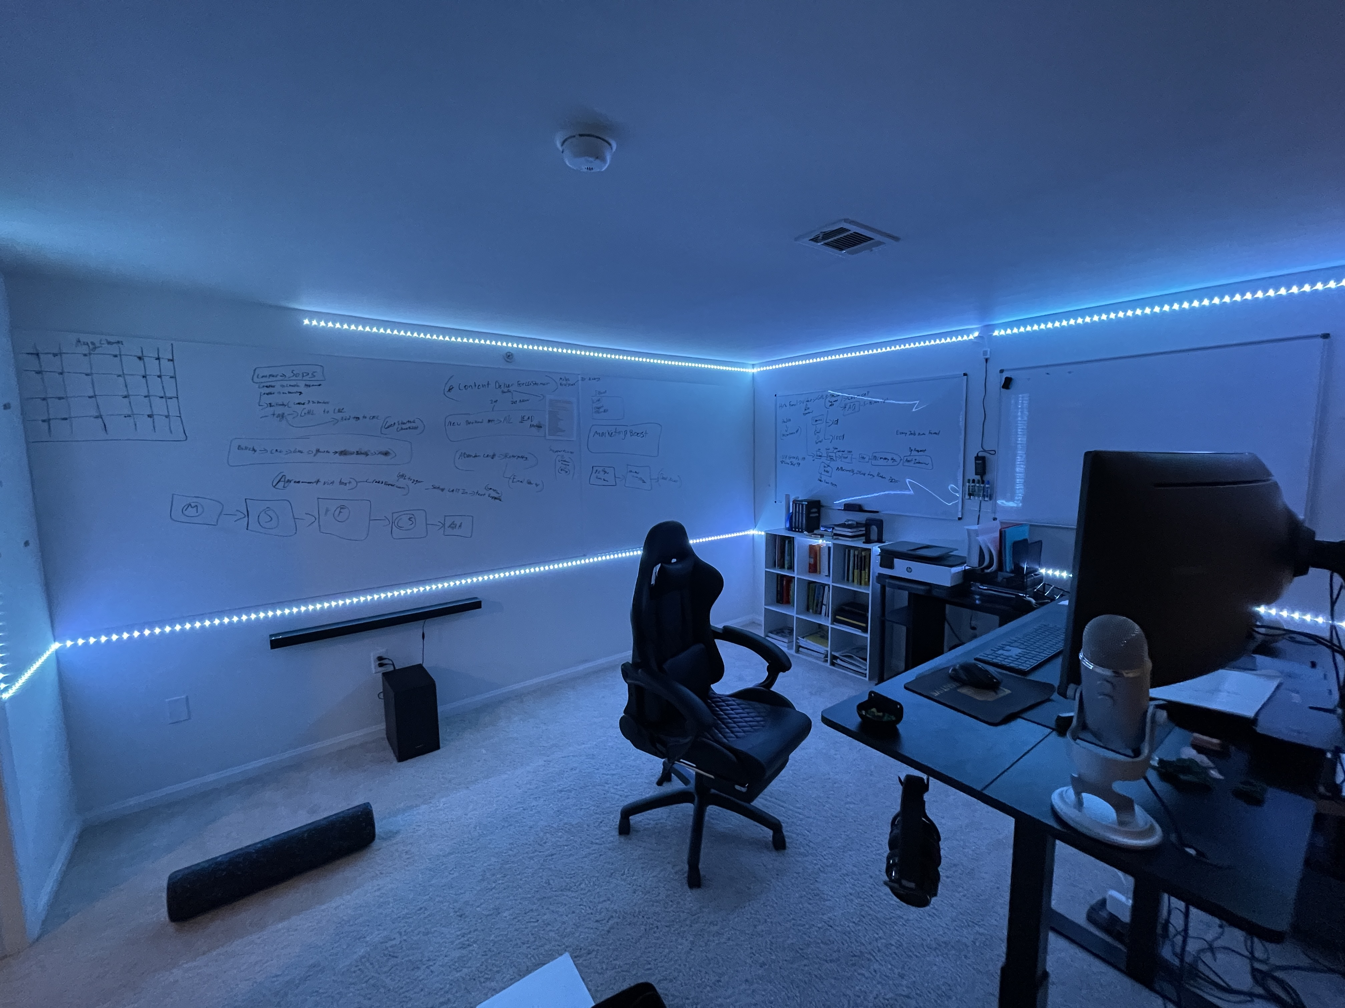
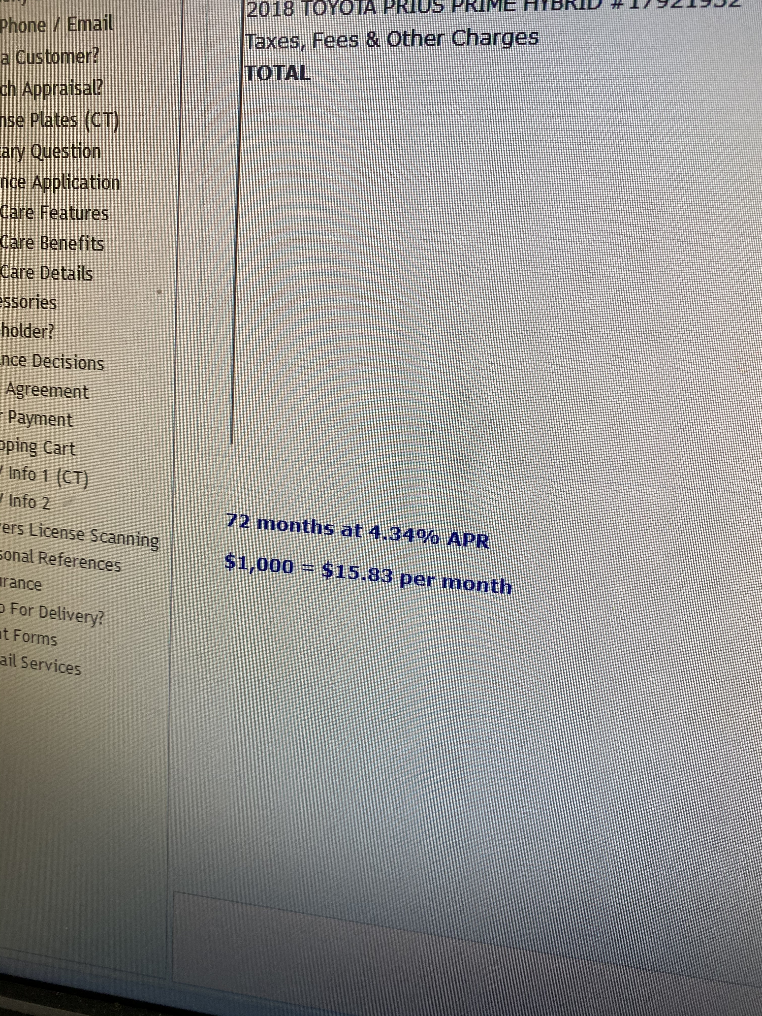

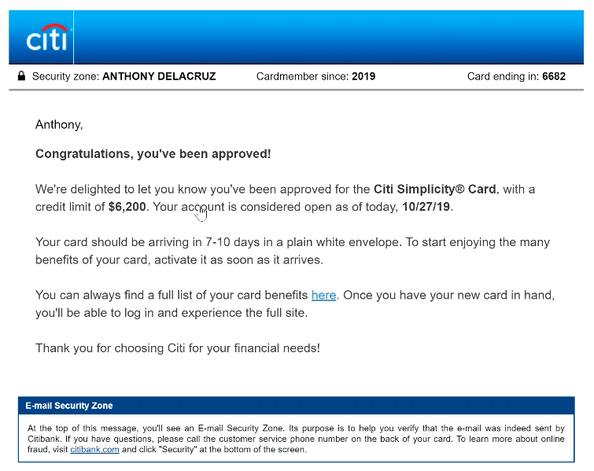

Notes:
I wrote a best selling book named How to Fix Your Credit
I post student results 2x a day on FB and instagram that’s over 700x a year and have hundreds of written and video testimonials of clients and students
I’ve taught financial topics in schools from credit, to investing in the stock market, to budgeting, to real estate

Slide 15
Notes:
I wrote a best selling book named How to Fix Your Credit
I post student results 2x a day on FB and instagram that’s over 700x a year and have hundreds of written and video testimonials of clients and students
I’ve taught financial topics in schools from credit, to investing in the stock market, to budgeting, to real estate

Slide 16
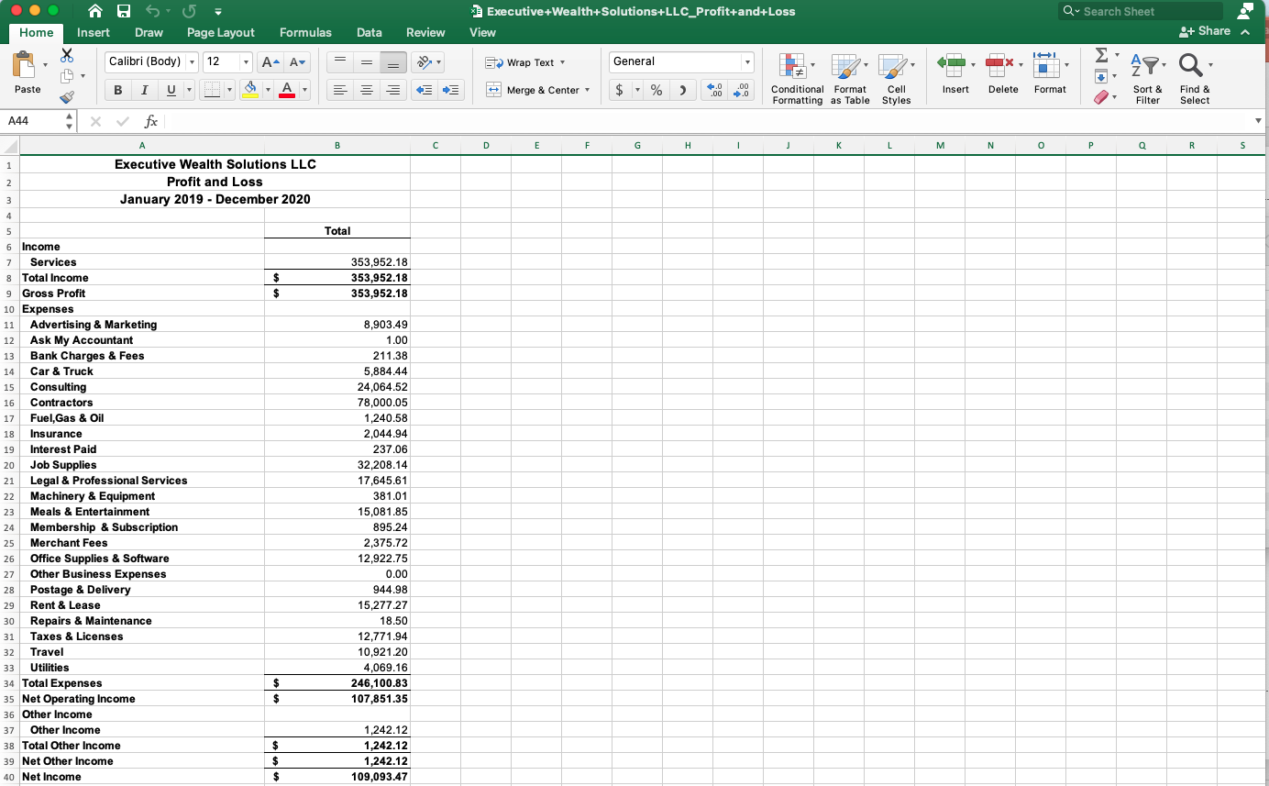

Slide 17
However, that’s where I am now, but I wasn’t always a Wealth Warrior...

Slide 18

Notes:
This can be you too if you structure your credit repair business the right way

Slide 19

Notes:
I remember it like it was yesterday when we had the conversation.
I was at a government site as a IT security contractor in D.C. and literally broke down snot down the nose crying because the person I known as a superhero took an L and I literally could do nothing about it.

Slide 20
Have you ever wanted to help someone that you loved, but couldn’t?
Notes:
Have you ever wanted to help someone that you loved but you couldn’t? I can tell you this it’s a horrible feeling!
I didn’t have the knowledge, I didn’t have the money, I didn’t have the network to help my mother who did so much for me despite starting behind the eight ball herself.

Slide 21
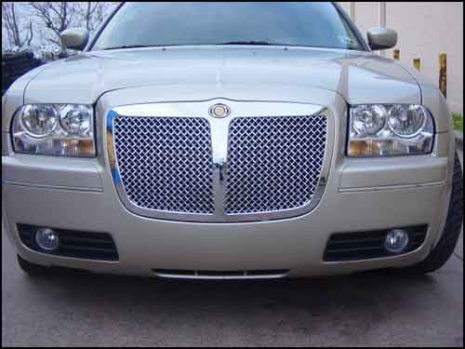
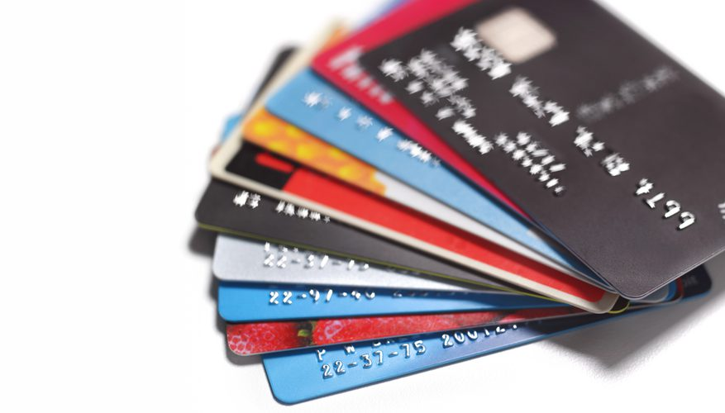

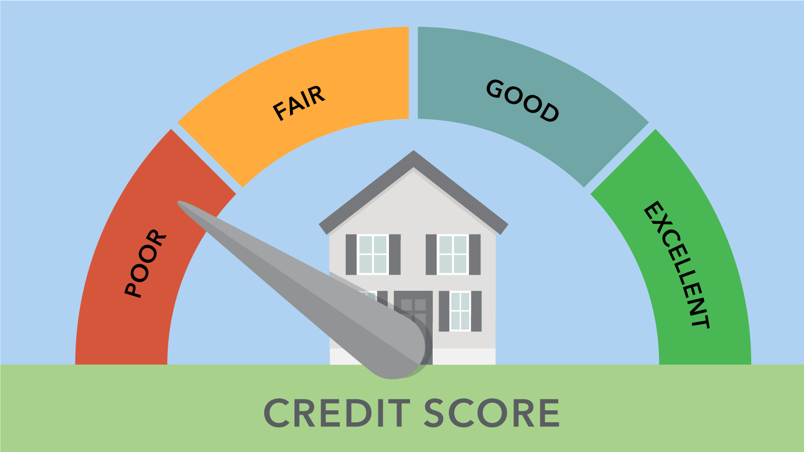

Notes:
My mother’s situation made me take a serious look at my financial house.
When I looked at my financial house
I had 20 credit cards all nearly maxed out.
I was renting an overpriced 2 bedroom apartment. I say overpriced, because it cost more to rent than own in my area!
A Chrysler 300 with the fake bentley grill and 20 inch rims with 20% interest car note. That means For every dollar I paid on my car note 20 cents went to interest
100k in student loans with credit score of 504.
I wasn’t motivated to be strong financially until someone I loved was hurt financially.
Then I got pissed because, I realized that in highschool and college the basic financial principles were not taught.
I guess you don’t know what you don’t know. However, studying 4 hours a day for a year I was able to find out what worked and what didn’t work. I created a personal finance system to get me and my mom out of the hole.
My first success story was my mom and the second success story was myself!

Slide 22

Notes:
You’re probably thinking..
Why am I telling you this?
Because I want you to know that I started with nothing. No strong male role model, No mentors, No rich uncles, No one to talk about money with at the dinner table. My friends were poor too! So Nothing!
This means I learned everything that got us to the the life we have today and beyond by books, seeking out people who had the life I wanted and the knowledge I needed, failing a lot and wasting a lot of time and money. The good news is you won’t have to go through what I had to go through to get results.
It’s all about executing on what you’re learning. If I can do it. You can. If you’re willing to put in the work.

Slide 23
WHEN I LOST MY EXCUSES I FOUND RESULTS
Notes:
Let’s get into how to improve your credit without being a credit expert. Honestly you don’t have to be a genius to have better finances. Just like you don’t have to be a world class athlete to have better health!

Slide 24
And right now I am going to teach you how to do this...
Notes:
And right now I am going to teach you how to do this!

Slide 25
What We'll Cover:
Secret #1: Why credit repair is a very lucrative recession proof business
Secret #2: How To Build a Credit Business from scratch with the right foundation.
Secret #3: How To Maximize your profits for your business
Secret #4: WHAT are The 5 pillars of Credit Repair (my own secret framework)
Secret #5: HOW TO AUTOMATE IT ALL!!!!!
Notes:
You’re going to learn 3 secrets to reaching your credit goals today. Secret #1 How To Remove Negative Items From Your Credit Report. Secret #2 is How To Improve Your Credit Without Being A Credit Expert and Secret #3 How To Improve Your Credit When You Are Short On Time!

Slide 26
Secret #1:
Why credit repair is a very lucrative recession proof business
Notes:
Let’s get into how to improve your credit without being a credit expert. Honestly you don’t have to be a genius to have better finances. Just like you don’t have to be a world class athlete to have better health!

Slide 27
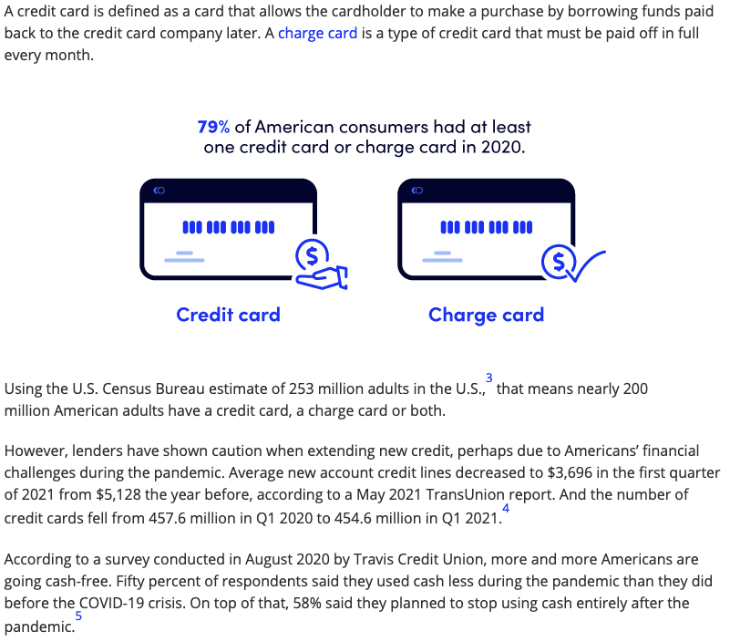

Slide 28
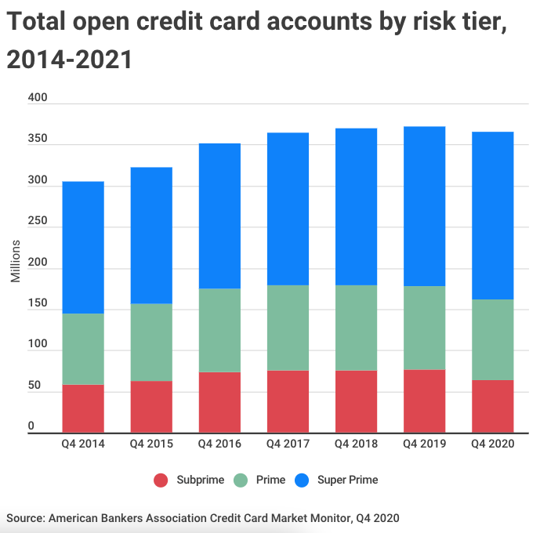

Slide 29
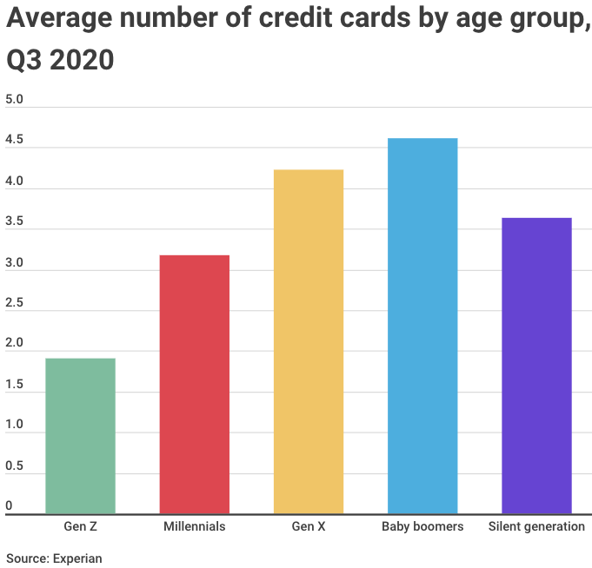

Slide 30
100,000 a month in revenue
Let’s break it down
Pricing ($100 a month per client)
You need 1,000 active clients a month
200 million consumers in the USA

Slide 31
Secret #2:
How To Build a Credit Business from scratch with the right foundation.

Slide 32
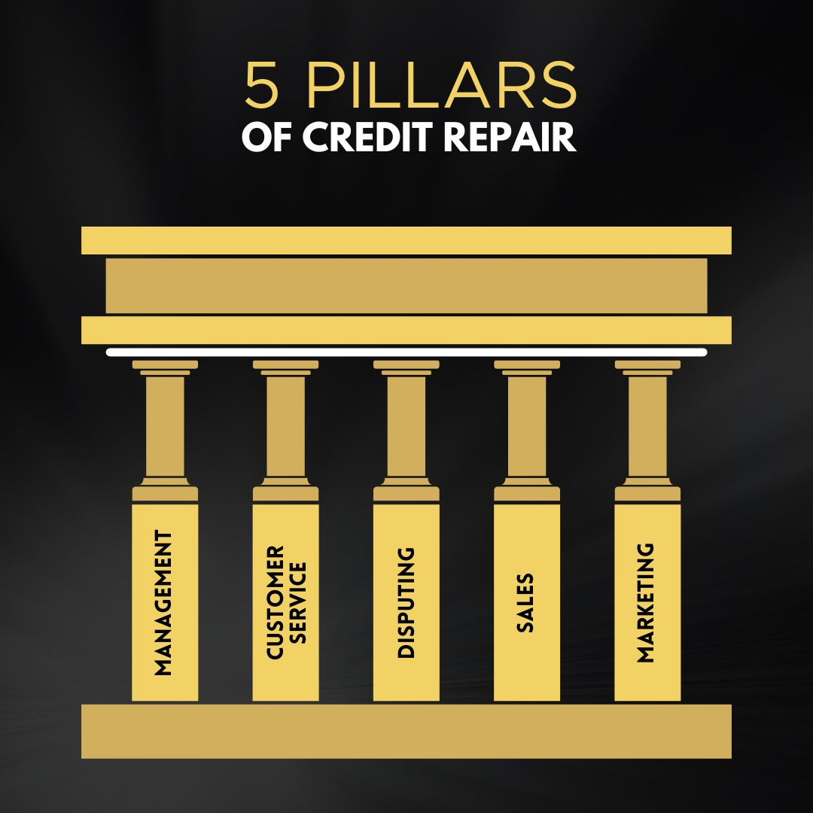
1ST STEP WOULD BE TO KNOW WHAT A CREDIT REPAIR BUSINESS NEEDS

Slide 33
MARKETING: Strategic marketing often results in growth for your business. If you successfully educate customers, keep them engaged, create a strong reputation in their minds and smartly sell to them, your business will most likely do well. Marketing is how you attract those customers in the first place.
SALES:
Sales play a key role in the building of loyalty and trust between customer and business... During sales interactions, encouraging the customer to recommend a friend or give positive feedback can have an impact on the growth of the business through increased brand awareness and sales
MANAGEMENT:
Management is important because It helps in Achieving Group Goals - It arranges the factors of production, assembles and organizes the resources, integrates the resources in effective manner to achieve goals. It directs group efforts towards achievement of pre-determined goals.
DISPUTES:
Having a well outlined and smooth order fulfillment process will help your business continue to draw customers and satisfy them with your service.
This formula helps keep retention in your business and helps with customer satisfaction.& over all experience. ​​​​​​​
CUSTOMER SERVICE:
Customer service is important to your business because it retains customers and extracts more value from them.
By providing top-notch customer service, businesses recoup customer acquisition costs and cultivate a loyal following that refers customers, serves as case studies, and provides testimonials and reviews.

Slide 34

DID YOU KNOW THAT 8/10 CREDIT REPAIR COMPANIES DON’T HAVE ANY STRUCTURE IN PLACE.
Notes:
Warning! Do you know why your credit score is different across all 3 credit bureaus?
Have you ever looked at your credit report and scores and see that they are different and think why?
The reason your scores vary is because not all of your creditors deal with all 3 bureaus. Some places that you do business with only deal with one or two places and you know something else? Even if you get your credit score directly from the credit bureaus it’s not the actual score.
Crazy huh? That’s why it’s more important to know what is on your credit report vs the actual score.

Slide 35

Notes:
Why? The information on the credit report is what makes up the score!
Content is king. I’ll repeat that, your credit report content is the king.
However, the credit report is created by the data within each credit bureau. So if we ensure the credit bureaus only have accurate and positive data aka accurate and positive content. We guarantee an excellent credit score. Regardless of where you obtain your credit score!
Write this down in the comments content is king! Write this down in your notes content is king.
Also, you have a different credit score depending on what you’re applying for! Yup. If you’re applying for a credit card your credit score will be different than if you’re applying for a mortgage or auto loan?
Why? Well, each lender is judging you slightly differently based on what I’m going to show you in secret #2, but let’s not get ahead of ourselves.

Slide 36
Secret #3:
How To Maximize your profits for your business!
Notes:
That moves us to Secret #3. Which is how to improve your credit when you’re short on time.

Slide 37
YOU CAN NOT SCALE WITHOUT MEASURING
Notes:
Remember.. When you lose your excuses and follow a proven system you will find results!

Slide 38

Notes:
The crazy thing is this, by having specific end goals you will be more than willing to put in the work to achieve that goal. By having specific end goals, you are going to be able to measure your progress in reaching those goals which will motivate you to work even harder during the process.
By having specific ending goals you not only will end up accomplishing everything that you set out to do, but I am willing to bet that you will accomplish your goals earlier than you originally planned.
It all starts with a vision, Being SMART and crafting a game plan to make that vision a reality, then working the game plan to obtain your vision.
I am willing to bet that you went through harder things in life than improving your credit. This is easy if you’re willing to put in the work to make it happen.
With your why written down and your focus on the goal let’s talk about what’s needed to make your goal and credit improvement happen!
You don’t need to be an credit expert if you have a specific goal and understand what makes the credit algorithm work!

Slide 39
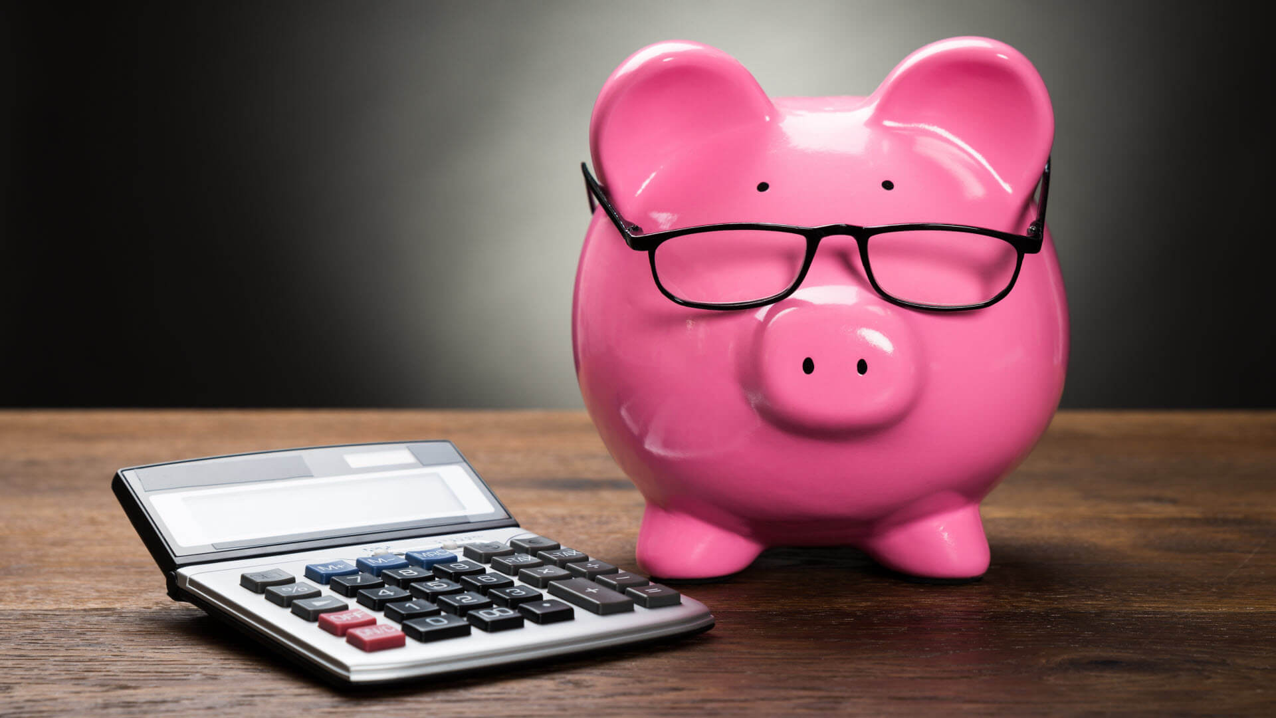
Notes:
To put it another way your credit is a byproduct of your financial behavior.
The good news is you have way more control over your credit score than you think.
As a matter of fact, like 4 out of the 5 things we are going to talk for secret #2 you have the ability to control and immediately improve your credit.

Slide 40
WHAT KIND OF EXPENSES
SOFTWARES AND SYSTEMS
EMPLOYEES
BUSINESS EDUCATION / CONSULTING
TRAVEL
RENT & LEASE
UTLITIES
ADVERTISING & MARKETING
LEGAL AND PROFESSIONAL SERVICES

Slide 41
(INFINITY) BUSINESS INCOME AND EXPENSE TEMPLATE
Notes:
SHOW IT LIFE

Slide 42
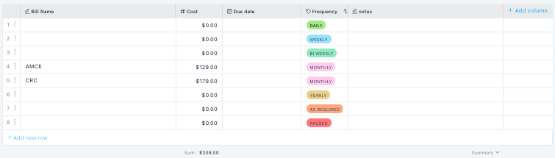
(INFINITY) BUSINESS EXPENSES TEMPLATE
Notes:
SHOW IT LIFE

Slide 43
PROFITS > EXPENSES
DIGITAL VS PHYSICAL
SOFTWARE
MAILING ONLINE
VIRTUAL ASSISTANTS
HAND WRITTEN
POST OFFICE
PHYISCAL EMPLOYEES
PHYSICAL HAS PROFIT MARGINS UP TO 55% TO 78%
DIGITAL HAS PROFIT MARGINS UP TO 85% TO 93%

Slide 44
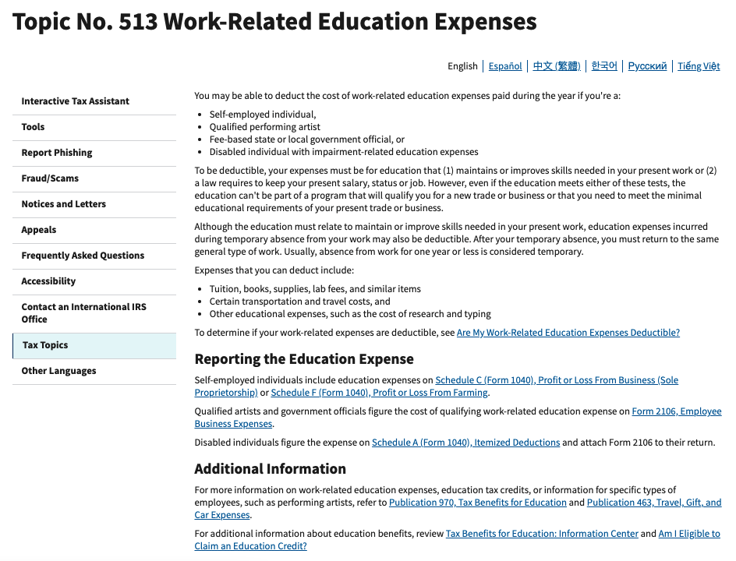
BUYING MY CREDIT REPAIR BUSINESS ACCELRATOR PROGRAM IS FORM OF CONSULTING
& YOU CAN WRITE IT OFF FOR YOUR BUSINESS

Slide 45
Secret #4:
WHAT are The 5 pillars of Credit Repair (my own secret framework)
Notes:
That moves us to Secret #3. Which is how to improve your credit when you’re short on time.

Slide 46
YOU MIGHT BE THINKING...

Slide 47
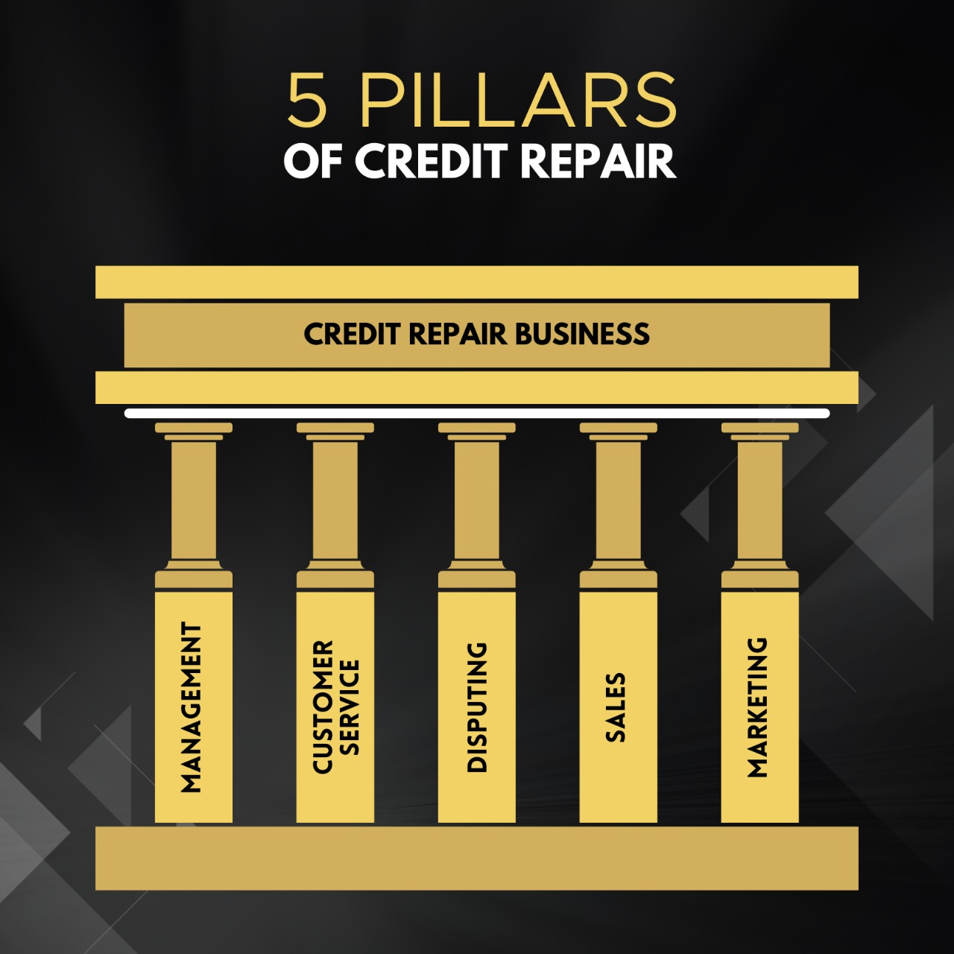

Slide 48
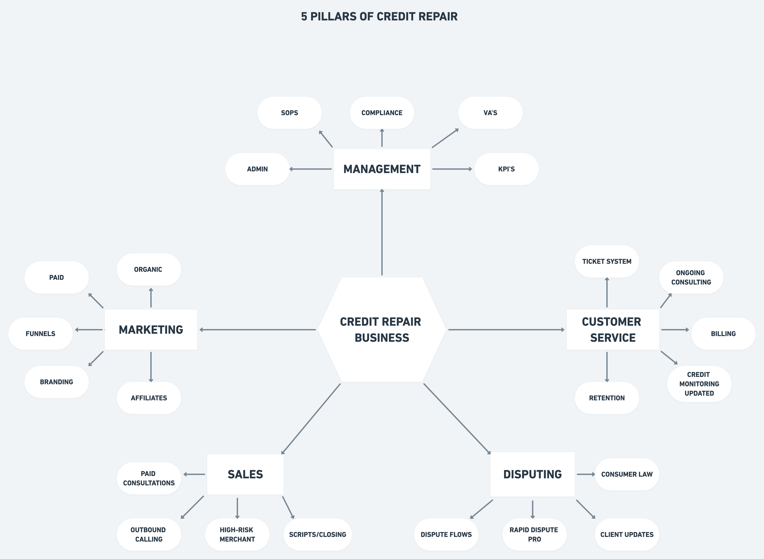

Slide 49
THAT’S THE PROCESS IN A NUTSHELL

Slide 50
Secret #5:
HOW TO AUTOMATE IT ALL!!!!!
Notes:
That moves us to Secret #3. Which is how to improve your credit when you’re short on time.

Slide 51


Slide 52
Many People Think...
Notes:
Many people think. Oh, I’m not good with money and have no clue about credit so good credit isn’t in my future. I used to feel the exact same way until I did this little trick and it made all the difference in my credit, finances and happiness.

Slide 53

Notes:
This is math not magic.
So we have our why, we know what credit is, what credit bureaus are, and why our score is always different, we even know the 5 parts that go into calculating a credit score. We now need to zero in on those 5 parts to see what we can do to improve our credit even more.
This is what I did with my mom and myself once I figured out the rules.
The 1st two things we talked about gave us a reason for playing the game and the rules of the game. Now let me show you how to dominate the game.

Slide 54

Notes:
A big big big mistake people make is assuming that paying off installment credit or obtaining installment credit will improve their credit score.
I know a lot of people with major influence getting this wrong on a daily basis. Let me make this very clear for you. If your goal is to improve your credit. Paying off your car loan, student loan, mortgage, a personal loan, getting self lender, getting your rent payments put on your account, getting a credit building loan, getting a car loan, getting a mortgage will not help your credit score.
Your score actually will go down before it goes up! Your focus should be on manipulating revolving credit by paying it down or obtaining more! Why? Because installment loans only care about you paying on time. Where as revolving credit cares about paying on time and how you use it, thus giving you more points. Because you impact the 35% and 30% bracket at the same time!

Slide 55

Notes:
Here’s the the truth! You can remove almost anything from your credit report if you follow the right disputing process. I’m talking collections, chargeoffs, bankruptcies, repo, student loans, collections, tax liens, child support. If there is a violation of your rights under the FCRA then it can be removed from your credit.

Slide 56
FREEDOM IS A FORMULA
Notes:
Remember.. When you lose your excuses and follow a proven system you will find results!

Slide 57
So let’s recap...
Notes:
So, let’s go ahead and recap.

Slide 58
Here are the 5 main secrets...
Secret #1: How To Build a Credit Business from scratch with the right foundation.
Secret #2: : Why credit repair is a very lucrative recession proof business
Secret #3: How To Maximize your profits for your business
Secret #4: WHAT are The 5 pillars of Credit Repair (my own secret framework)
Secret #5: HOW TO AUTOMATE IT ALL!!!!!
Notes:
You’re going to learn 3 secrets to reaching your credit goals today. Secret #1 How To Remove Negative Items From Your Credit Report. Secret #2 is How To Improve Your Credit Without Being A Credit Expert and Secret #3 How To Improve Your Credit When You Are Short On Time!

Slide 59
So You Might Be Thinking..
Notes:
I’m afraid to make a mistake or make my situation worse, or I don’t know where to start or I was never taught about money, or I don’t have discipline.
Here is the thing.. everyone is afraid, nobody knows where to start, we weren’t born taught about money and discipline is something you work at.

Slide 60
SO WHAT NOW?
Notes:
Remember.. When you lose your excuses and follow a proven system you will find results!

Slide 61

Notes:
The main reason why you would think you do not have enough time to improve your credit is because you really don’t know where to start. This is where I was when I was trying to figure it all out and I had to bounce from facebook group to facebook group and youtube channel and youtube channel.

Slide 62
So at this point you have 2 options...
Notes:
So, at this point you have 2 options. Okay.

Slide 63
Go it alone and try to do it yourself without any help...
#1
Notes:
Number one is you can take the information that I've shared with you today and you can try to do it yourself without any help and just go out on your own

Slide 64
Get it right the FIRST time by learning from someone that has done it successfully over and over.
#2
Notes:
or number two, you can get it right the first time by learning from someone that's has done it successfully over and over for himself and thousands of people and you can get 24/7 help from the thousands of people I've helped that have done it successfully.

Slide 65
If you chose #2, that’s a smart decision, and here is why…
Notes:
So, if you chose number two and let me know. Can you just... here real quick, in the chat, can everybody just put one or two in the chat. I wanna see which one you will choose. Okay, one, go it alone or number two, get help. Let me know in the chat box which one you would choose. All right. Okay, I see a ton of 2's, 2's, 2, 2, 2. Awesome, awesome. So, obviously if you chose number two, that's a smart decision, and here is why.

Slide 66
All the Frameworks and strategies I showed you today…
Notes:
All the success screenshots I showed you today

Slide 67
only scratches the surface. Not even a dent...
Notes:
You see, the methods that I have showed you today, they only scratch the surface, not even a dent. It's enough to get you started, it's enough to get you out there, it’s enough to get you motivated.. But if you really want to get massive results, and the support you need to do it right then the How To Fix Your Credit course is for you!

Slide 68
But they all have ONE thing in common…
Notes:
they all have one thing in common. They have all purchased a premium product from me and that premium product is my online training and Mastermind community and that is why I'm so happy to introduce it to you today.

Slide 69

Introducing:
”CREDIT REPAIR BUSINESS ACCELERATOR"
HELPING CREDIT REPAIR BUSINESSES GROW & SCALE
Notes:
I would like to introduce to you the “How To Fix Your Credit Course” inside of the Your Finances Simplified Academy! This one program alone has changed so many lives and we are constantly updating it with new information!

Slide 70

FREE OFFER FOR YOU AT THE END

Slide 71
8 WEEKS OF CONTENT TO HELP YOU SET UP YOUR BUSINESS THE RIGHT WAY.
Notes:
Let me breakdown just some of the things you’re going to get in the Your Finance Simplified Academy - How To Fix Your Credit Course.
#1. You’re going to get 100+ dispute letters for every credit situation. I’m talking the exact letters I use in my 7 figure credit repair company. The exact letters that the hundreds of credit repair companies I trained use. All you have to do is modify for your unique situation and send it off.. oh I show you how to do that as well :-).

Slide 72
1. 8 WEEKS OF CONTENT TO HELP YOU SET UP YOUR BUSINESS THE RIGHT WAY.
2. Access to our framework shown in the training
Notes:
The 2nd thing you will get is my disputing process and templates. Having the letters isn’t enough. You need to be able to track your processes along the way to ensure the credit bureaus, original creditors and debt collectors are doing what they are supposed to do!

Slide 73
1. 8 WEEKS OF CONTENT TO HELP YOU SET UP YOUR BUSINESS THE RIGHT WAY.
2. Access to our framework shown in the training
3. Access to our amazing Credit repair Scripts
Notes:
You also get my Guaranteed Approval Credit Boosting Credit Plan. I show you step by step how to properly build credit while you are working to get items removed!

Slide 74
1. 8 WEEKS OF CONTENT TO HELP YOU SET UP YOUR BUSINESS THE RIGHT WAY.
2. Access to our framework shown in the training
3. Access to our amazing Credit repair Scripts
4. Marketing tactics working for us currently
Notes:
You also get my step by step procedures on how to remove any type of negative item on your credit report. You will get my exact system for handling collections, bankruptcies, student loans, charge offs, repossession, late payments. For example, the process for handling a collection is different from a charge off. Tackling a bankruptcy is different from a repossessions. I demystify the process and tell you exactly what to do and when.

Slide 75
1. 8 WEEKS OF CONTENT TO HELP YOU SET UP YOUR BUSINESS THE RIGHT WAY.
2. Access to our framework shown in the training
3.Access to our amazing Credit repair Scripts
4.Marketing tactics working for us currently
5.Business Credit basics to build your companies business credit
Notes:
You also will get my step by step procedures on building and obtaining credit regardless of your credit score. I show you what you should do if your credit score is between 0 to 640 and what you should do if your credit score is 640 and above!

Slide 76
1. 8 WEEKS OF CONTENT TO HELP YOU SET UP YOUR BUSINESS THE RIGHT WAY.
2. Access to our framework shown in the training
3.Access to our amazing Credit repair Scripts
4.Marketing tactics working for us currently
5.Business Credit basics to build your companies business credit
6.Bonuses for you
(How to create your own tradeline company)
(learning who & what you can sue for)
Notes:
You also get a world class credit education. It’s not enough to simply tell you what letter to send, how to respond, and how to build credit. I will teach you the why’s behind it all, so you can go on to teach your loved ones. You will be a credit expert and 100% credit self sufficient. You will know how to understand, improve and protect your credit as if you’re a credit expert.

Slide 77
WHAT ABOUT THE FULL PROGRAM?
Notes:
Remember.. When you lose your excuses and follow a proven system you will find results!

Slide 78
Here's What You're Going To Get:
ACCESS TO THE FULL CREDIT REPAIR BUSSINESS ACCERATOR PROGRAM W/ OVER 100+ VIDEOS (Total Value: $4997)
Notes:
I’ve sold this course alone in the past for $497 and honestly I could have sold it for so much more because of all the value it provides. However, since you’re on this class I’m not going to sell it for that high of a price.

Slide 79
You Also Get...
Notes:
That’s not all because you’re also going to get...

Slide 80
Credit Business Success Tools
Access to our Credit Repair Resource library
Dispute board with over 40+ dispute letter (litigation process)
Access to our Facebook group
Access to our infinity Structure templates
Business audit call with Me or one of my Team Experts
Access to Automate my credit empire (my very own system)
Access to a delegation structure to help you scale
Free trial for our Rapid dispute pro button
Mastermind footage from our last mastermind (Expert footage)
AND MUCH MORE
Notes:
You also get my credit success tools. I’m going to give you a discount on the the best credit monitoring for actually repairing your credit. You will get credit monitoring on all 3 credit bureaus, ID Theft Protections for your family. Daily alerts with monthly score tracking so you can respond to anything that may pop up. A score simulator, 1 million in identity theft protection for you that will cover your legal fees and loss of funds if you are a victim of identity theft and complete coverage and protection of your information from the dark web. Many people think you can rely on credit karma, credit sesame, or the credit reports from the credit bureaus to repair /monitor their credit. Those are actually the worst credit monitoring you can use! Why? Well they all sell your data to debt collectors and creditors. They also do not offer enough information within the credit report to perform credit repair!

Slide 81
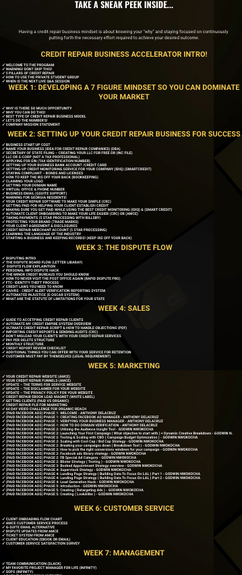
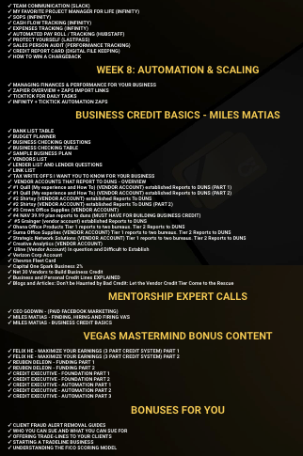
OVER 100+ PIECES OF CONTENT FOR YOU AND YOUR
BUSINESSS DEVELOPMENT

Slide 82
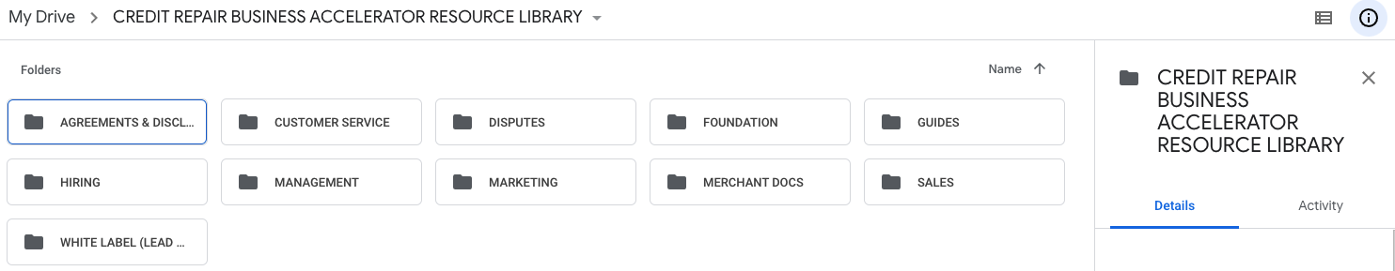
OUR CREDIT REPAIR RESOURCE LIBRARY

Slide 83
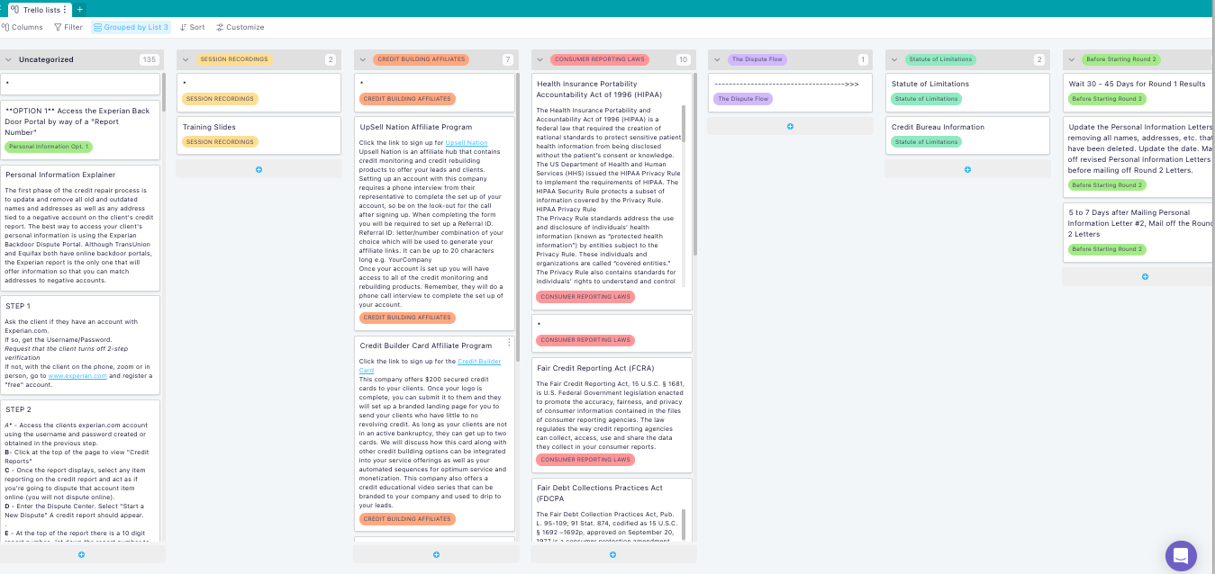
LITIGATION DISPUTE FLOW W/ OVER 40+ LETTERS

Slide 84

ACCESS TO OUR PRIVATE FACEBOOK GROUP

Slide 85
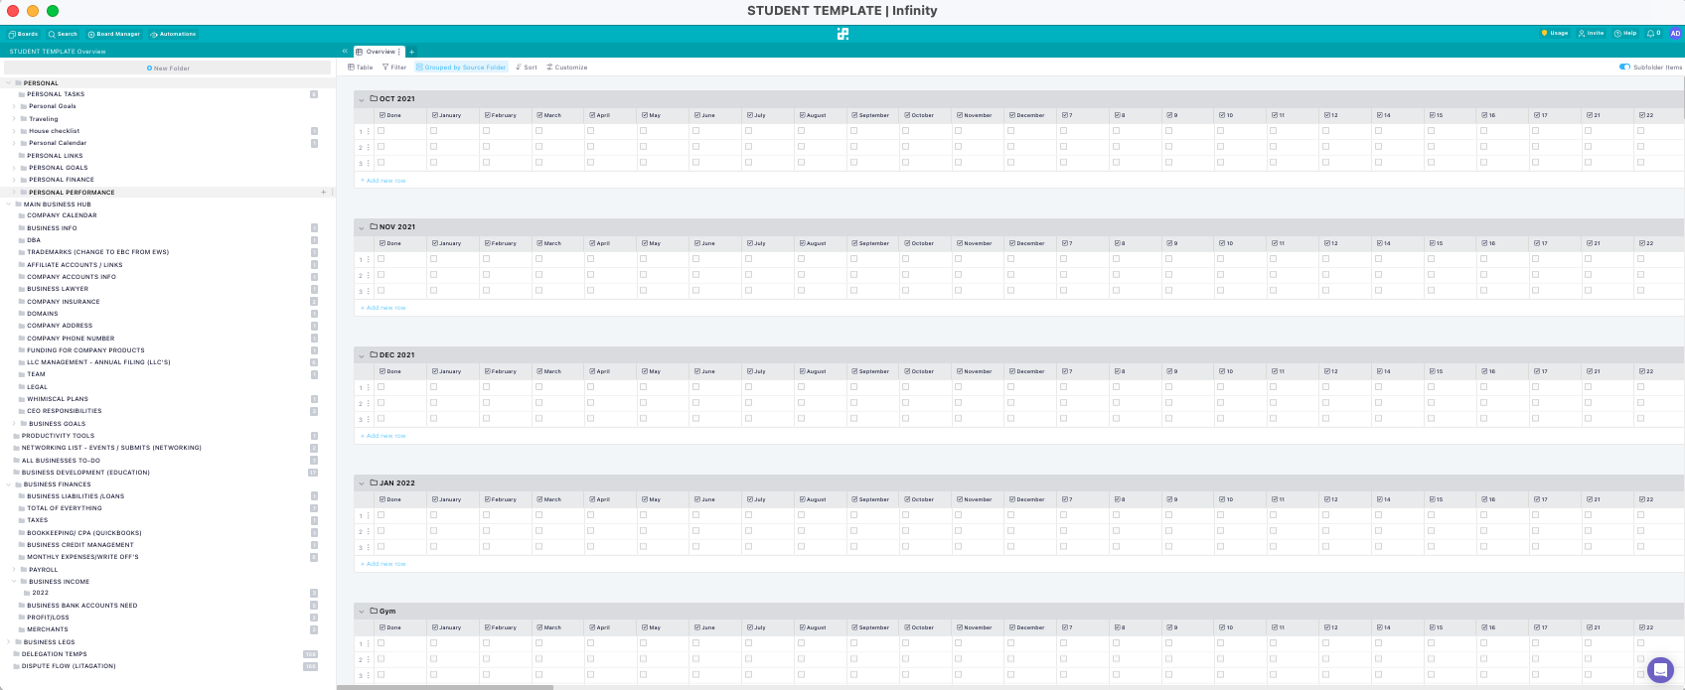
Access to our Infinity structure templates

Slide 86
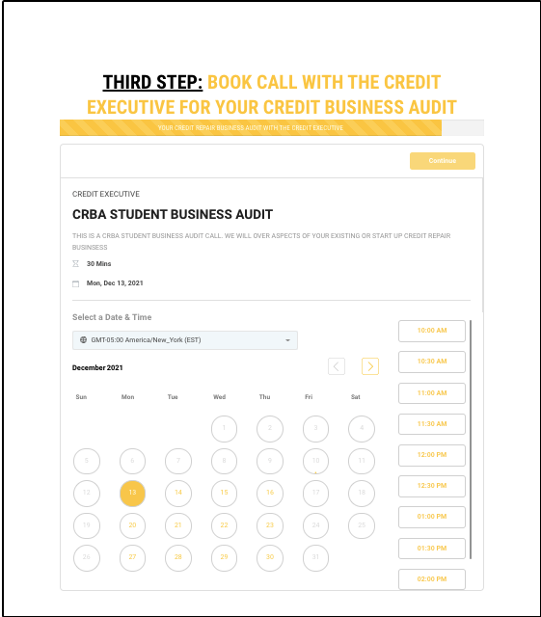
BUSINESS AUDIT CALL WITH ME OR MY TEAM

Slide 87
ACCESS OUR AUTOMATE MY CREDIT EMPIRE SYSTEM
CREATE FULL WEBSITES, FUNNELS & LANDING PAGES
SALE PIPELINE
ONBOARDING PIPELINE
CUSTOMER SERVICE PIPELINE
CUSTOMER SERVICE TICKET SYSTEM
DISPUTE UPDATING SYSTEM (AUTOMATED)
ONLINE APPOINTMENT SCHEDULING
ALREADY DONE FOR YOU TEXT AND EMAIL CAMPAIGNS
DOMAIN HOSTING
WORK FLOW TO BUILD CUSTOM AUTOMATIONS
TRIGGERS TO AUTOMATE TASKS
CALLING SYSTEM FROM PLATFORM
CALL TRACKING, RECORDING AND REPORTING
DRAG & DROP SURVEYS AND FORMS
EASILY CUSTOMIZE YOUR FOLLOW-UP CAMPAIGNS
CREATE MULTI-CHANNEL CAMPAIGNS
TWO-WAY COMMUNICATION ON ANY DEVICE
AUTOMATED NURTURE CONVERSATIONS
FULL CUSTOMIZATION OF MESSAGING
ARTIFICIAL INTELLIGENCE BUILT IN
FULL FEATURED COURSE MANAGEMENT
OFFER FREE AND PAID COURSES (UNLIMITED USAGE!)
MANAGE YOUR WORKFLOW AND PIPELINE
COLLECT CUSTOMER PAYMENTS
ALL THE ANALYTICS & REPORTS IN ONE PLACE

Slide 88
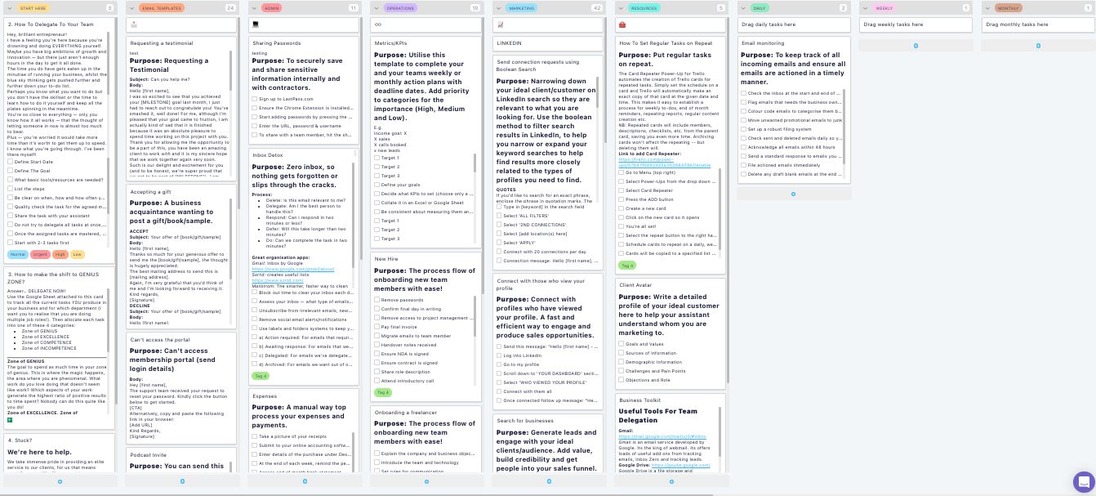
DELEGATION STRUCTURE TEMPLATES

Slide 89

FREE TRIAL TO RAPID DISPUTE PRO (ONE CLICK DISPUTE SOFTWARE)

Slide 90
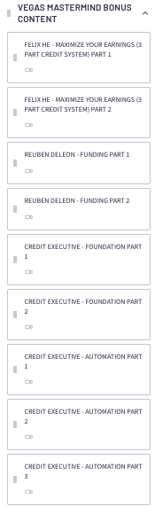
OUR LAST MASTERMIND EVENT FOOTAGE
EXPERTS CALLING ABOUT FUNDING, BUSINESS SCALING
AND ME TALKING ABOUT BUSINESS FOUNDATION AND AUTOMATIONS
TOTAL OF 7 HOURS OF EXCLUSIVE NEVER SEEN BEFORE FOOTAGE

Slide 91
I’M NOT DONE… You’re also getting
Notes:
Remember.. When you lose your excuses and follow a proven system you will find results!

Slide 92
MASTERMIND GROUP ACCESS FOR 2022
WILL HAVE ACCESS TO MASTERMINDS HELD IN THE WHOLE YEAR.
FILLED WITH CREDIT REPAIR EXPERTS TO BRING VALUE TO YOU.
MASTERMIND PRIVATE GROUP CHAT
UNDISCLOSED LOCATION IN THE USA TO MAIN EXCLUSIVITY.
YOU WILL RECEIVE TONS OF VALUE FROM SPEAKERS.
THERE WILL BE A CHANCE TO STAY THE HOUSE WITH MY AND THE SPEAKERS.
YOU WILL RECEIVE A FULL RECORD OF THE WHOLE MASTERMIND.
THIS IS A ONE TIME OFFER AT CHECKOUT! SO GRAB IT WHILE YOU CAN. BEFORE ALL SEATS ARE FILLED

Slide 93
I Had 3 Choices...
Make this affordable so everyone could access, but have poor quality...
Charge a lot of money and work with a few people and provide a ton of value...
Make this affordable and provide a ton of value...
Notes:
Now, I had 3 choices when I decided what to price this at today.
I could make it affordable so everybody could gain access, but have poor quality.
I could charge a lot of money, provide a ton of value, but only service a few people.
Or.. I can step up to the challenge my daughter set out for me and make this affordable, provide a ton of value and give you exactly what you need to reach your goals and so much more…
I chose option #3

Slide 94
LIMITED TIME OFFER
FOR THE NEXT 30 DAYS

Slide 95
ACCESS TO THE FULL CREDIT REPAIR BUSSINESS ACCERATOR PROGRAM W/ OVER 100+ VIDEOS (Total Value: $4,997)
Access to our Credit Repair Resource library ($497 Value)
Dispute board with over 40+ dispute letter (litigation process) ($997 Value)
Access to our Facebook group ($97 Value)
Access to our infinity Structure templates($997 Value)
Business audit call with Me or one of my Team Experts($297 Value)
Access to Automate my credit empire (my very own system) ($4997 Value)
Access to a delegation structure to help you scale ($997 Value)
Free trial for our Rapid dispute pro button($97 Value)
Mastermind footage from our last mastermind (Expert footage) ($1,997Value)
Total Value: $15,970
TODAY YOUR PRICE WILL BE $1,997 FOR REGULAR PACKAGE
TODAY YOUR PRICE WILL BE $2,997 FOR MASTERMIND GROUP PACKAGE
CLICK LINK TO GET STARTED!!!!
Notes:
Let’s add it all up..
You’re getting the How To Fix Your Credit Course which is valued at $497, the credit success tools for a value of $497, the How To Create The Perfect Budget Course with a value of $497, The How To Invest in the stock market course for a value of $497, the How To Buy A Home The Smart Way Course for a value of $497, The How To Get A Pay Raise Course for a value of $497, The How To Start A Business and Obtain Business Credit Course for a value of $997. The Purpose to Profit Challenge for a value of $297, The 52 Week Savings Challenge for a value of $297 and the Purpose To Profit on Instagram for a value of $297. That means you’re getting $5367 of value for less than $1 a day. I’m giving you everything that you should have learned about finances in school for the most affordable price possible. I’m giving you the tools and lessons that will empower you to change your family tree!

Slide 96
2 Reason Why People Don't Get Started
Notes:
You might be thinking wow the course sounds awesome, but I can’t get started because...

Slide 97


Notes:
I do not have 497 dollars to take this awesome course or I do not have the knowledge to improve my credit. Here is the good news!

Slide 98
Why?
Notes:
Why?

Slide 99
To be brutally honest, it’s because of their environment. Their friends and family cannot understand what they are trying to do, doubt them, and are usually not supportive.
Notes:
Well, to be brutally honest, because of their environment. Their friends and their family cannot understand what they're trying to do, they doubt them, and they are usually not supportive.

Slide 100
Most people start things with great intentions, but as soon as they hit one single bump they give up...
Notes:
Most people start things with great intentions, but as soon as they hit one single bump they give up...

Slide 101
Success thrives in an environment of support, and withers and dies in an environment without it!
Notes:
You see, success thrives in an environment of support, and withers and dies in an environment without it.

Slide 102
I know what this feels like because I spent years in a group of family and friends that were all under achievers and kept me down…
Notes:
I know what this feels like because I spent years in a group of family and friends that were all under achievers and kept me down…

Slide 103
Once I started hanging around with successful people, I became successful…
Notes:
Once I started hanging around with successful people, I became successful.

Slide 104
You need to be in an environment of people that speak the same language and have the same mission as you…
Notes:
You need to be in an environment of people that speak the same language and have the same mission as you.

Slide 105
You need to be around people that lift you up and encourage you, not put you down…
Notes:
You need to be around people that lift you up and encourage you, not put you down…

Slide 106
That’s exactly why I created the Credit Repair Business Accelerator Community!
Notes:
That’s exactly why I created the Wealth Builders Elite Community!

Slide 107
So we can win and fail together and dominate the market there are individuals and families who need our services make progress in their financial life
& I would love to be apart of that journey with you
Notes:
We have over 2000 students working and achieving their financial goals.. and they are more than willing to help you succeed as well..

Slide 108

Notes:
because the bottom line is you can build something great. I've already helped hundreds and hundreds of people build something great while reaching their financial goals but you need help and I'm here and my community here is here to help you win

Slide 109
Q & A...
HOW DO I KNOW IF THIS PROGRAM IS MEANT FOR ME?
Notes:
The YFS Academy is a do it yourself program. I give you all you need to win financially no matter your education level for a cost that you can afford.

Slide 110
Q & A...
HOW MUCH MONEY CAN I MAKE?
Notes:
You do not need a lot of money to improve your credit. The process is the same if you make a million a year or only get an SSI check. What you need is a proven system so you don’t waste money or time. If your income is limited you want get the best program and community possible so you do it right the first time. This is what I’m offering you today with the YFS Academy.

Slide 111
Q & A...
START UP COST OF THE BUSINESS?
Notes:
It varies. I’ve seen people gain 100 points in my program in 45 days. However, the average since 2009 has been roughly 100 points in 90 to 180 days. Now, to be 100% honest it’s the combination of disputing, credit building, budgeting, focus and accountability that makes the score jump that quickly. This is math, not magic. It’s very similar to fitness. If you workout and eat right you will see results quickly. If you follow proven disputing procedures, budget, build credit and stay on track you get results.

Slide 112
Q & A...
CAN THIS BUSINESS BE COMPLETELY AUTOMATED?
Notes:
Yes! The YFS Academy has over 100+ dispute letters and templates for challenging any negative item on your credit. Late payments, inquiries, repo’s, evictions, foreclosures, charge offs, collections, tax liens, judgements. You name it there is a process / letter for it.

Slide 113
Q & A...
WILL THIS GET IN THE WAY OF MY OTHER PROJECTS?
Notes:
Disputing items on your credit report will not make your credit score worse. If it’s on your credit report already it’s already negatively impacting you. Challenging items does not reset how long it will remain on your credit report either. I cover this in a bit more details within the education sections of the how to fix your credit course.

Slide 114
Q & A...
HOW OFTEN ARE THE LIVE CALLS?
Notes:
Disputing items on your credit report will not make your credit score worse. If it’s on your credit report already it’s already negatively impacting you. Challenging items does not reset how long it will remain on your credit report either. I cover this in a bit more details within the education sections of the how to fix your credit course.

Slide 115
Q & A...
IS THIS JUST A ONLINE PROGRAM?
Notes:
This is a huge misconception! debt collectors like to play on your ignorance of the law. There is something call statue of limitations. I cover this in the YFS Academy in detail, but you have a state state of limitations and federal statue of limitations. State statue of limitations determines when you can no longer be sued and it varies depending on state and type of contract. The federal statue of limitations is what credit reporting is based on. It’s generally 7.5 years from the date of your last payment and has nothing to do if the debt is transferred or sold to a 3rd party. Just make sure you do not make any partial payments and reset your clock!

Slide 116
Q & A...
HOW LONG IS THE LIMITED TIME OFFER BEING OFFERED?
Notes:
Yes! Now repossessions are a different beast and I have a special section for how to handle them. You are going to have to deal with the credit bureaus, the auto loan dealer and specific state requirements. You can’t treat repo where it’s voluntary (you gave it back) or involuntary (they took it) the same as you do a late payment or collection.

Slide 117
ACCESS TO THE FULL CREDIT REPAIR BUSSINESS ACCERATOR PROGRAM W/ OVER 100+ VIDEOS (Total Value: $4,997)
Access to our Credit Repair Resource library ($497 Value)
Dispute board with over 40+ dispute letter (litigation process) ($997 Value)
Access to our Facebook group ($97 Value)
Access to our infinity Structure templates($997 Value)
Business audit call with Me or one of my Team Experts($297 Value)
Access to Automate my credit empire (my very own system) ($4997 Value)
Access to a delegation structure to help you scale ($997 Value)
Free trial for our Rapid dispute pro button($97 Value)
Mastermind footage from our last mastermind (Expert footage) ($1,997Value)
Total Value: $15,970
TODAY YOUR PRICE WILL BE $1,997 FOR REGULAR PACKAGE
TODAY YOUR PRICE WILL BE $2,997 FOR MASTERMIND GROUP PACKAGE
CLICK LINK TO GET STARTED!!!!
Notes:
Let’s add it all up..
You’re getting the How To Fix Your Credit Course which is valued at $497, the credit success tools for a value of $497, the How To Create The Perfect Budget Course with a value of $497, The How To Invest in the stock market course for a value of $497, the How To Buy A Home The Smart Way Course for a value of $497, The How To Get A Pay Raise Course for a value of $497, The How To Start A Business and Obtain Business Credit Course for a value of $997. The Purpose to Profit Challenge for a value of $297, The 52 Week Savings Challenge for a value of $297 and the Purpose To Profit on Instagram for a value of $297. That means you’re getting $5367 of value for less than $1 a day. I’m giving you everything that you should have learned about finances in school for the most affordable price possible. I’m giving you the tools and lessons that will empower you to change your family tree!

Slide 118
HERE IT IS
CLICK THE LINK FOR YOUR FREE COURSE

